Slide 1
NBA Draft Combine Measurements

Slide 2
Objective
The Objective of this Project is to analyse the trends in NBA dataset
How different features are related to one other and give some important analytical observation.
Benefits
Proper Understanding of the NBA Dataset
Which feature is most important in drafting players.
We may get with the most accurate feature which relates to find player having more ability to win.

Slide 3
Data Sharing Agreement
Dataset comes by combining the csv (2012,13,14,15 and 16) having 306 rows and 18 columns
10 columns in Dataset have NaN values
There is one object type column name “PLAYER” and 1 Int( type) and 16 are Float type columns
Memore usage of dataset is 46kb so, we do not need to optamize the memory.

Slide 4
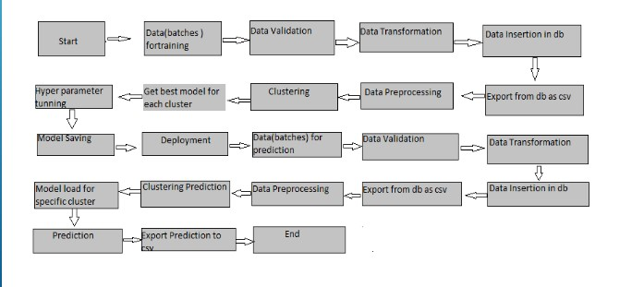
Architecture

Slide 5
Name of file-we have created file name as per the year of the NBA ,it was played on.
Number of columns-all columns of the combined dataset can be seen in one data set and we can see the total column
Name of columns-name of columns is visible using pandas.columns funtion.
Data Type – data type can be seen using pandas dtypes function.
Null Values in columns –can be seen using pandas is null function

Slide 6
Data Insertion
Dataset can be directly downloaded from Kaggle or can be imported from skearn ,seaborn etc
If we use the seaborn or sklearn to import data we have to use sklearn.load_dataset_name, seaborn.load()
If we have dataset in our directory then we may use
Pandas.read_csv(“path of your csv file”)

Slide 7
Data visualization
There are many libraries and tools in python to visualize the data features ex: Matplotlib , seaborn, plotly,cufflinks, tableau etc
We are using df.plot(kind=“ ”,x=“”,y=“”) a matplotlib library to visualize relation between feature in 1D or 2D
We can use plotly to visualize the 3D graph
px.iplot(kind=“”,….) library of cufflinks and plotly.
For ploting count or frequency we use countplot in seaborn

